Slide 1


CAMPUS SECURITY STAFFS MANAGEMENT SYSTEM
Ngô Quang Khiêm
Đỗ Duy Minh

Slide 2


INTRODUCTION
Technologies Used:
Visual Studio (WinForms, C#)
MySQL
DevExpress/Component Libraries (if available)
Reason for Choosing This Topic:
There is a growing need to manage work schedules, attendance, and staff tracking in educational institutions (campuses).
Currently, most of these tasks are handled manually or using Excel, which is inefficient and error-prone.

Slide 3


Support the security management team in:
Scheduling shifts for security staff
Monitoring duty status and leave requests
Automatically calculating salaries based on working hours
Managing staff profiles
Optimizing manual processes → automating workflow
SYSTEM OBJECTIVES

Slide 4



TARGET USERS
Manager:
Create duty schedules
Approve leave requests
Monitor staff status
Calculate salaries
Security Staff:
View personal duty schedule
Submit leave requests

Slide 5


MAIN FEATURES
Login
·Decentralization: Manager and Security Staff
Manager Dashboard
·Create an on-site schedule for the next 7 days
·Approval of leave application
·Track actual employee status
·Automatic payroll calculation according to schedule
·View each employee's calendar details
Security Staff Dashboard
·View your personal calendar
·Submit a leave of absence application

Slide 6
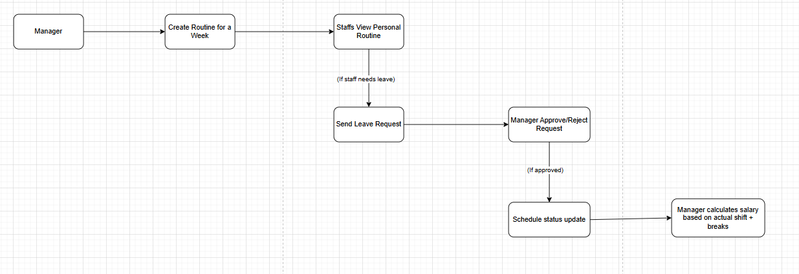
SYSTEM WORKING FLOW

Slide 7
DATABASE
Main tables:
Users: User information (ID, name, role, etc.)
routine: schedule
leave_requests: Leave application
Places:
salary: salary spreadsheet (if any)
ERD (Entity Relationship Diagram)

Slide 8
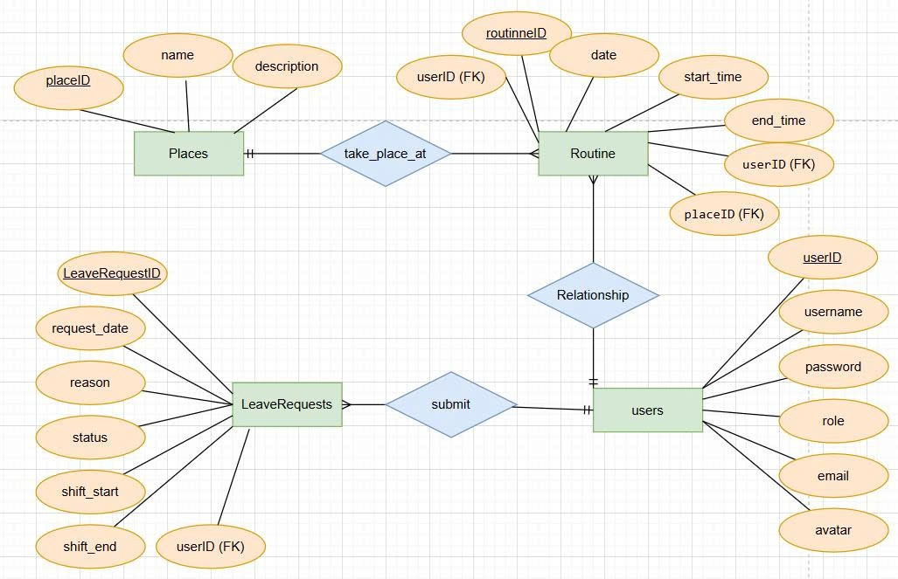
ER DIAGRAM

Slide 9
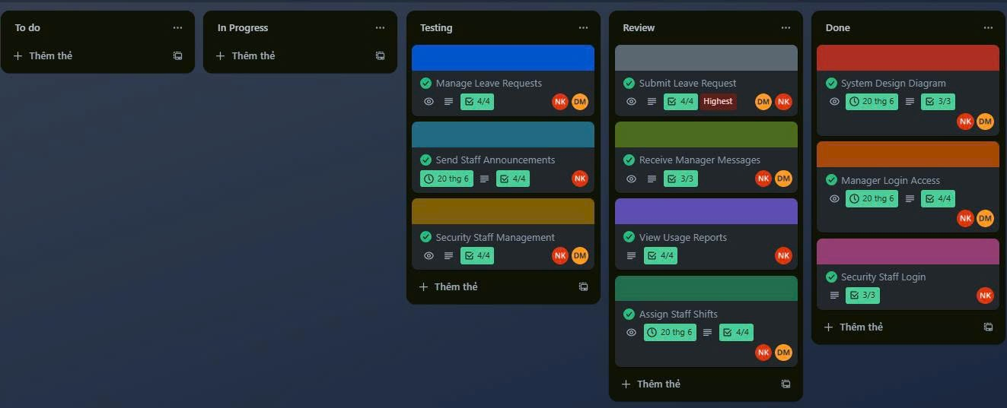
TRELLO

Slide 10
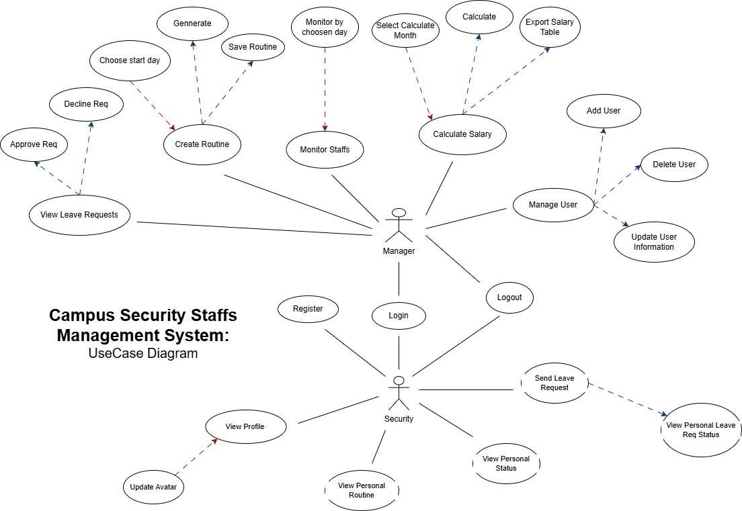
USERCASE DIAGRAM

Slide 11
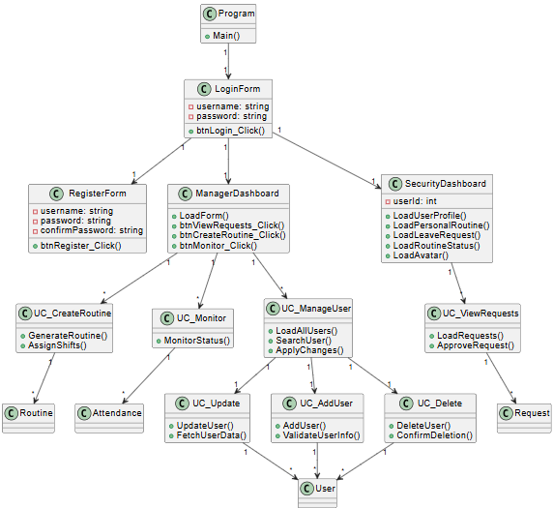
CLASS DIAGRAM

Slide 12

APPLICAITON
DEMO

Slide 13
PROJECT CONCLUSION
The Campus Security Staffs Management System streamlines staff scheduling, attendance tracking, and payroll calculation. By automating manual tasks, it enhances efficiency, reduces errors, and supports better management of security personnel in educational institutions.

Slide 14
THANK YOU
CONTACT DETAILS
GROUP 8
khiem.ngo.cit20@eiu.edu.vn
0898466792

